Slide 1

BUSINESS
ANALYSIS

Slide 2
INTRODUCTION Swiggy has rapidly grown to become one of the most popular food delivery services in India.
Swiggy's platform allows users to order food from a wide range of restaurants in their area and have it delivered to their doorstep in a timely and convenient manner. Swiggy also offers a range of features such as real-time order tracking, in-app chat support, and multiple payment options to enhance the user experience.
In addition to food delivery, Swiggy has also expanded into other areas such as hyperlocal delivery, groceries, and medicine delivery. As of 2021, Swiggy operates in more than 500 cities across India and has a strong network of delivery partners and restaurant partners.

Slide 3
Objective
Scrape the data from swiggy’s website and analyze it.
After analyzing we have presented the data in table with details of different column.
Identify the various factors like highest rating, most popular cuisines, expensive restaurant, location wise rating via graphs.
Finally we managed to get some insights from the data and we have made a dashboard according to it.

Slide 4
Insights

Slide 5
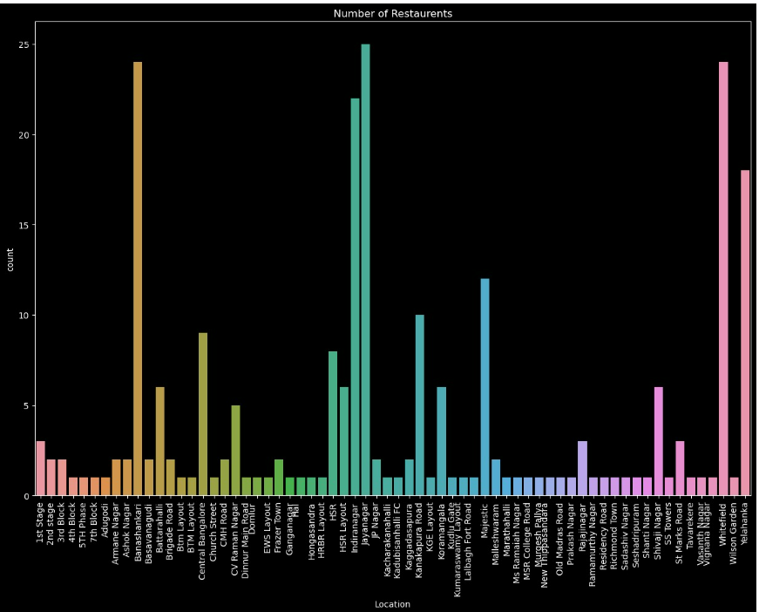
Area wise distribution of restaurant

Slide 6
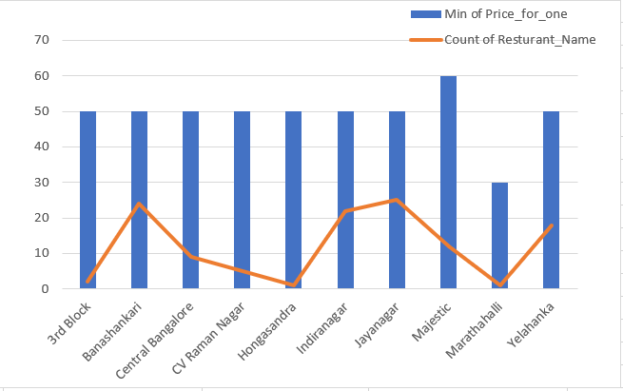
AREA WISE CHEAP RESTAURANT

Slide 7
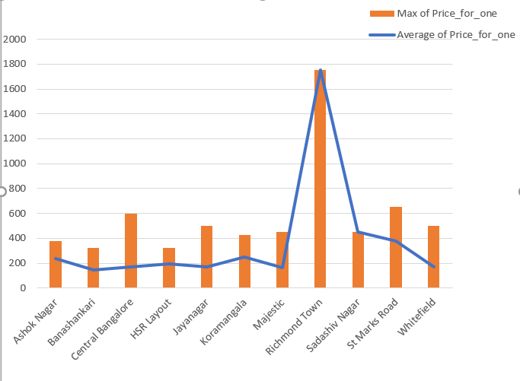
Area wise expensive restaurant

Slide 8
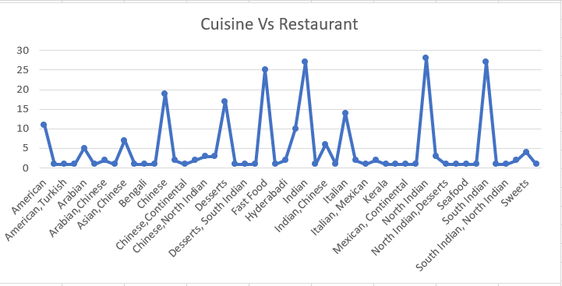
Number of restaurant for each type of cuisine

Slide 9
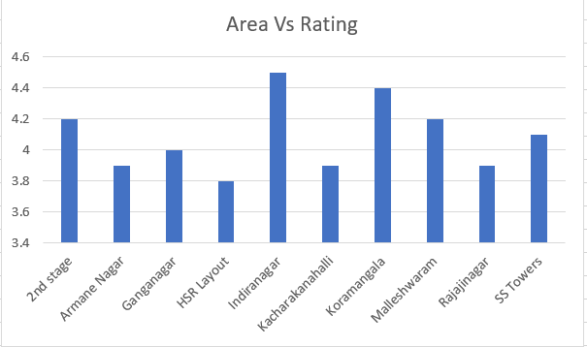
Area wise rating distribution

Slide 10
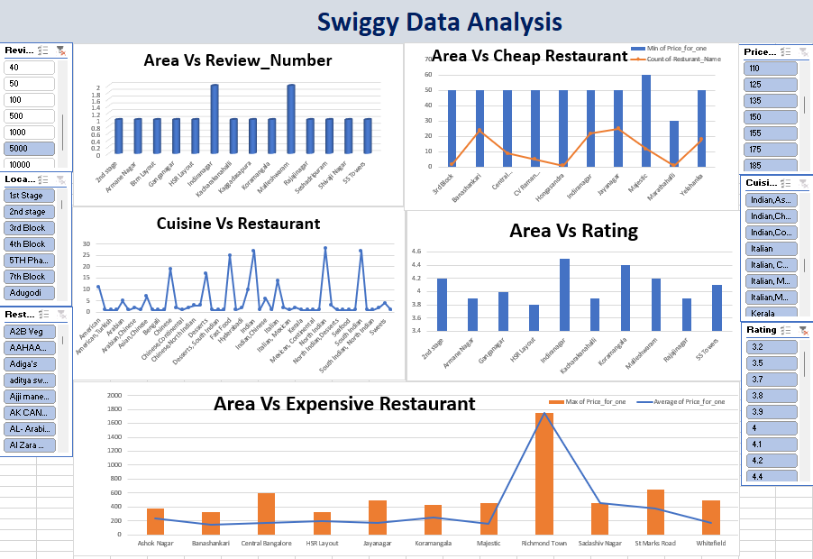
dashboard

